Slide 1

4th Quarter In-Person Provider Meeting

Slide 2

MEETING AGENDA ​
​
TOPICS
Reimbursement Services Updates​
Contract Updates​
Questions​
School Readiness Education
Family Services Updates
Grants
FSCJ Updates​

Slide 3
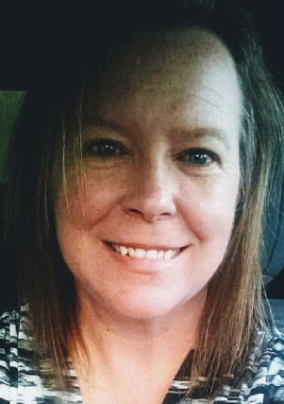
Family ServiceS Dept. Updates
Shanda Ellis

Slide 4
VPK End of Year Reports
The Division of Early Learning (DEL) has created a report to show any VPK children that have been paid for more than 540 hours. This report will be processed monthly from now until the end of the program year.
If your program has any VPK children that are over 540 hours a Family Services team member will be reaching out to you letting you know of the child’s termination date and any hours that will be taken back from payment.
It is always our goal to catch the overages in a timely manner and terminate the child before more payment is made.

Slide 5
VPK Over Hours Continued
Reasons why a child may be over hours:
VPK reenrollment from a program that provided different hours. Such as going from a 3 hour a day class to a 5 hour a day class.
VPK reenrollment into a program with a different start date than yours. Such as reenrolling from a program that started in August, but your program may not have started until October.

Slide 6
VPK Child Applications
VPK Child Applications for the 2023-2024 VPK Program Year opened in the Family Portal on January 1, 2023.
Family Services Specialists are working in the VPK Child App submitted queue daily for both the 2022-2023 and 2023-2024 program years.
VPK Age Eligibility
If a child was born between September 2, 2017 and September 1, 2018, they are eligible to participate in either the 2022 -2023 School Year Program (540 hours) or the 2023 Summer program (300 hours).
Children born between February 2, 2018 and September 1, 2018 may postpone their VPK participation until the 2023-2024 School Year Program (540 hours) or the 24 Summer Program (300 hours).
If a child was born between September 2, 2018 and September 1, 2019, they are eligible to participate in either the 2023 -2024 School Year Program (540 hours) or the 2024 Summer program (300 hours).
Children born between February 2, 2018 and September 1, 2018 may postpone their VPK participation until the 2023-2024 School Year Program (540 hours) or the 24 Summer Program (300 hours).

Slide 7
VPK Enrollments for 23/24 Program Year
*Providers must have a certified DEL-VPK 20 Statewide VPK Provider Contract.
*Please wait until you have 4 signed VPK Certificate of Eligibility (COE) Forms for an active classroom before you submit for enrollment approval.
*If you have a child that is enrolled and then drops from your program before you calendar start date, please click the orange button “Child Never Attended”.
*If a child drops your program after your calendar start date, then you will want to terminate the enrollment and choose from the drop-down list as to why the child is being terminated.
*If you have 4 children enrolled, but do not have 4 children start on your calendar start date, you will need to change your calendar start date to start the first day you have four children attend. It is very important that you make this change quickly to ensure your calendar stays at 540 hours.

Slide 8
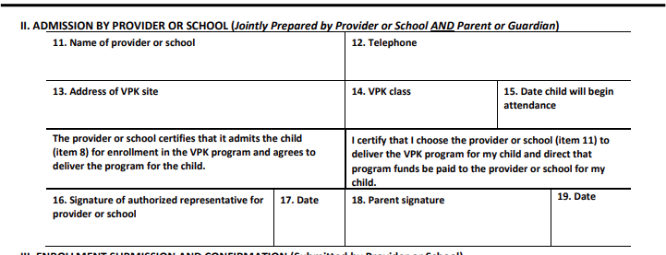
VPK Certificate of Eligibility (COE)
Please remember when you enroll a child into your VPK program you must complete Section II of the COE with the family. Please also complete for reenrollment COEs as well.
Once completed, please upload the COE into the document library folder named VPK Enrollment Certificates. You may do this by classroom or by individual certificates. These signed documents should be kept on file for 5 years.

Slide 9
School Readiness Wait List
Please encourage families to apply for the wait list at: https://familyservices.floridaearlylearning.com/
  Please note: When applying for School Readiness Services, the family will be required to upload one supporting document to verify eligibility for the program. A list of acceptable proof of eligibility documents will be available in the application process. This list will vary based on the information entered in the application.
  If you have questions regarding a specific family and their situation as to whether they would qualify to be added to the waitlist, please encourage them to reach out to our Program Support Coordinator Kenya Register at kenya.register@ecs4kids.org or 904-726-1500 ext. 2246.
We will continue weekly funding notices as long as enrollment trends stay the same.

Slide 10
We are enrolling through the waitlist for
ALL ELIGIBLE AGE GROUPS!
Clients apply for the wait list through the family services portal. Once the application is received the family will receive notification within 10 days from the date that they submitted as to whether they qualify or not. They must apply for services in the county they reside in.
To qualify for services a parent must be working or going to school for at least 20 hours per week or a two- parent family must have both parents working for a total of 40 hours per week. Eligibility is based on the federal poverty level which considers total family income and family size.
Once a family qualifies, they will be placed on our waiting list. Currently, funding notices are being sent out (via email) from the waiting list weekly. However, we cannot promise that this will continue to be the situation. The sooner families apply, the sooner they may receive services.
Normally, when funding notices are sent out, they are sent to Priority 3 or non-school age children and siblings under the age of 9. However, for now, as we clear the waitlist each week, we are including School Aged children through the age of twelve (12) in the available funding notices going out!
Please note, a funding notice does not automatically qualify families for SR funding. The funding notice generated will explain all documents needed to be uploaded with thirty (30) days to fully complete the application process. Full eligibility cannot be determined until all documentation is received, reviewed and verified meeting income and family size qualifications.

Slide 11
ECS Redetermination Processes
When a record comes up for redetermination ECS does the following:
  Send out a fourteen (14) day termination notice to both provider and client listing documentation needed for redetermination as well as a “on or before” due date.
  If a record is resubmitted for redetermination processing, ECS will strive to process the record before the redetermination date so that the record does not go into a Past Due status. However, if ECS is not able to process the submitted record before the redetermination date, the client is still covered under the original eligibility until the record is processed and approved or processed and terminated.
  Please Note: Since the client can upload and submit the redetermination documentation up until midnight of the redetermination date, ECS is not always able to redetermine all clients by their redetermination date. ECS now has ten (10) days to process these documents.
  When terminating any client, ECS will do their best to send a notification the day of the termination to both the provider and client, as well as make phone calls as time allows as a best practice. Unfortunately, with not having more control of the timing of submissions, this is not always possible due to current workloads. For this reason, it is important that you are aware of clients and children that are set to redetermine.

Slide 12
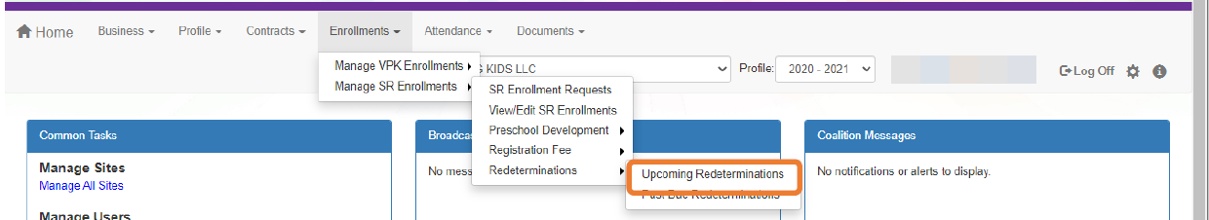
View Upcoming SR Redeterminations in the Portal.
The SR Eligibility Redetermination menu allows providers to view enrollments with “upcoming” or “past due” redeterminations. These queues are for informational purposes only and aid providers in knowing when an enrolled child is reaching the end of their School Readiness eligibility.
Upcoming Eligibility Redeterminations
  To see the enrollments with upcoming eligibility redeterminations, navigate to Enrollments > Manage SR Enrollments > Redeterminations > Upcoming Redeterminations.
  Redetermination records will only appear in the Provider Portal Upcoming Redetermination queue when:
  Child eligibility status is Eligible
  Child enrollment status is Enrolled or Pending Family Acceptance
  The redetermination is within 45 days from the due date

Slide 13
View Past Due SR Redeterminations in the Portal.
Past Due Eligibility Redeterminations
To see the enrollments with past due eligibility redeterminations, navigate to Enrollments > Manage SR Enrollments > Redeterminations > Past Due Redeterminations.
Redetermination records will only appear in the Provider Portal Past Due Redetermination queue when:
Child eligibility status is Eligible
Child enrollment status is Enrolled or Pending Family Acceptance
The redetermination is at least one day past the redetermination due date

Slide 14
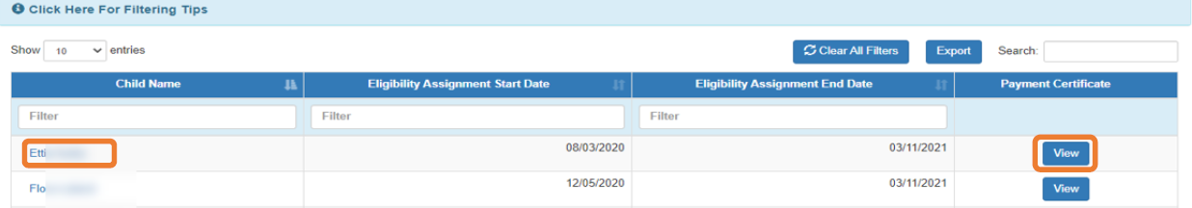
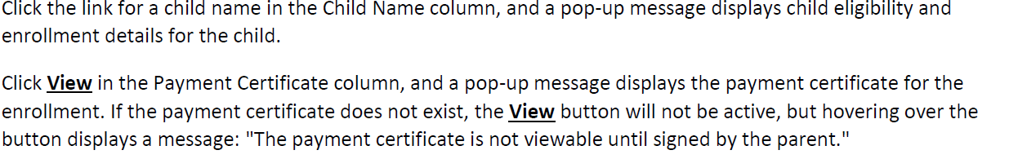
Redeterminations in the Portal continued.
After clicking the Upcoming Redeterminations or Past Due Redeterminations link, the following appears.

Slide 15
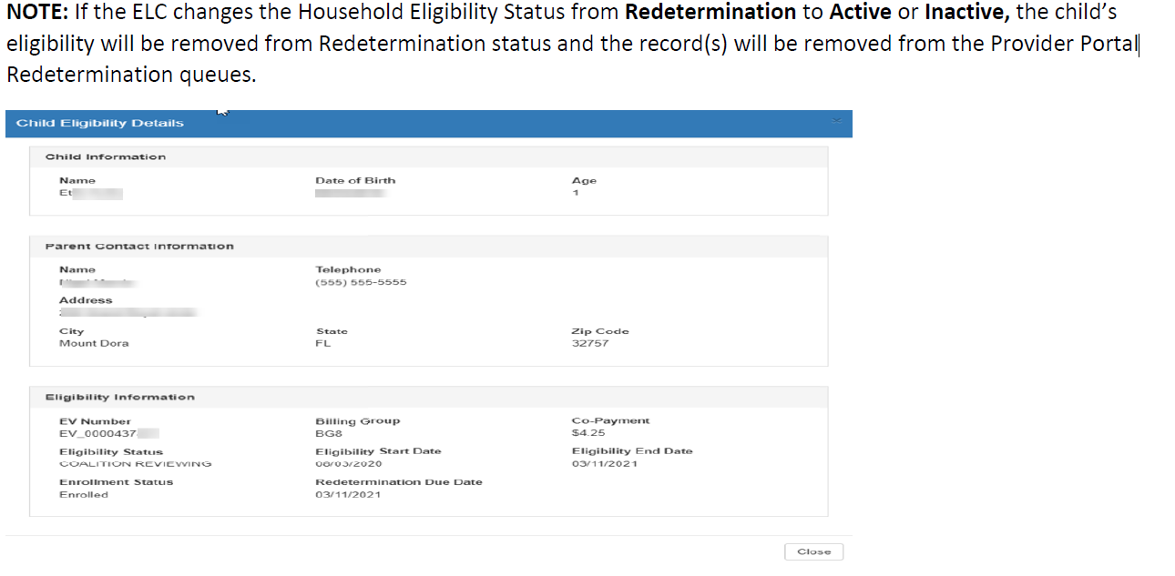

Slide 16
Provider Transfers
When a parent wants to transfer to a different provider, we require them to complete a Provider Transfer Form.
This form will need to show that the parent has a $0 balance with the provider they are leaving. This form needs to be completed before the transfer can occur.
If a parent is leaving your center and the parent owes a balance. ECS can only stop the transfer if there are parent fees owed. If there is another balance owed, we do encourage the parent to work out a payment plan with you, but we cannot stop the processing of the transfer. Please refer to Rule 6M-4.400(7) regarding transfers of School Readiness children and for the provider co-payment requirements refer to Rule 6M-4.400(5)
If a parent owes parent fees at the time of transfer, we can hold the parent responsible to pay those fees BEFORE approving the transfer.
We cannot stop a provider transfer for clients on a DCF referral, as typically they do not have a parent fee, and they are also considered must serve. If they owe a balance to you at time of transfer, we do encourage them to set up a payment plan. If you are unable to unable to arrange a payment plan with the at-risk child’s guardian, the provider shall document the repayment attempt and submit to the coalition to be placed in the child’s record.

Slide 17
SR Enrollment Terminations
When terminating a School Readiness enrollment through the Provider Portal please be sure to select an accurate reason from the drop-down menu provided. If in doubt of which selection to choose, please reach out to a Family Services Specialist to discuss.
If using the code for disruptive behavior, please reach out to one of our Inclusion Specialists before terminating the child.
    Rebecca Huth – Inclusion Specialist for Clay, Nassau, Baker and Bradford
    Jhordan Johnson – Inclusion Specialist for Putnam and St Johns
      Rebecca.huth@ecs4kids.org – 904-726-1500 ext 2281
      Jhordan.johnson@ecs4kids.org – 904-726-1500 ext 2227

Slide 18
SR Classroom Space Availability
We are in the process of calling contracted SR providers regarding space available in your programs. However, if you’d like to email me at Shanda.Ellis@ecs4kids.org with any openings you have at your program I will document your openings. This information helps us understand any deficits of age groups in our service area.
Other data we are seeking is to see if programs have any space, they could open another classroom in. If so, what concerns do providers have about opening other classrooms. This information helps us to understand and research how we may help with any resources in opening more classrooms and offering more space for families if funding or grants were available in the future.
I would love to hear your thoughts and encourage you to email me or call me at 904-726-1500 ext 2253. Thank you!

Slide 19
One Stop Office Staff & Central Staff
Family Services Specialists | Family Services Specialists
Baker – Eryss Meguia – 904-259-4255 Eryss.Meguia@ecs4kids.org | St Johns – April Florida – 904-770-2565 ext. 105 April.florida@ecs4kids.org
Bradford – Vickie Hancock - 904-964-1543 vickie.Hancock@ecs4kids.org | St Johns – Martha Castaneda – 904-770-2565 ext. 101 Martha.Castaneda@ecs4kids.org
Nassau – Holly Poole – 904-432-0009 ext. 2626 Holly.Poole@ecs4kids.org | St Johns – Sharron Green – 904-770-2565 ext. 100 Sharron.green@ecs4kids.org (Family Services Asst.)
Clay – Jacki Chimino – 904-213-3939 ext. 2081 Jacki.chimino@ecs4kids.org | Putnam – Christina Jackson – 386-385-5450 ext. 2284 Christina.Jackson@ecs4kids.org
Clay – Leatricia Ahmadu – 904-213-3939 ext. 2039 Leatricia.Ahmadu@ecs4kids.org | Central – Florine Reeves – 904-726-1500 ext. 2273 Florine.reeves@ecs4kids.org
Clay – TBD– 904-213-3939 ext. 2081 | Central – Shalanda Hall – 904-726-1500 ext. 2263 Shalanda.hall@ecs4kids.org

Slide 20
School Readiness Management Team
Emily Taylor– 386-385-3450 ext. 2881 (emily.taylor@ecs4kids.org) Family Services Coordinator to Clay, Putnam and St Johns staff.
Mary Catherine Quigley – 904-726-1500 ext. 2290 (mary.quigley@ecs4kids.org) Family Services Coordinator to Nassau, Baker, Bradford and Central staff.
Michele Goytia – 904-213-3939 ext. 2082 (michele.Goytia@ecs4kids.org) Child Care Resource and Referral Coordinator, all counties.
Kenya Register – 904-726-1500 ext. 2246 (kenya.register@ecs4kids.org) Program Support Coordinator, all counties.
Shanda Ellis – 904-726-1500 ext. 2253 (Shanda.ellis@ecs4kids.org) Manager of Family Services.

Slide 21

Questions?

Slide 22

Provider Services Updates
Shivaughn Williams

Slide 23
ARPA Child Care Stabilization Subgrants​
If you submitted your applications for the ARPA Childcare Stabilization Subgrant Round 1 installment 3 or Round 2 prior to the deadline. Staff are currently reviewing the application.
Payment will be made 30 days from approval date.
Please submit any questions to contracts@ecs4kids.org.​

Slide 24

Reimbursement Services Updates

Slide 25
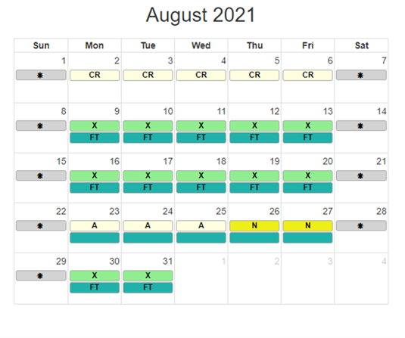
Attendance
Attendance Reminders!
Submit SR/VPK Attendance by the 3rd of each month
  This ensures that Providers receive proper payment in a timely manner.
    SR Payment is disbursed the 20th of every month
    VPK Payment is disbursed the 30th or 31st of every month

Slide 26
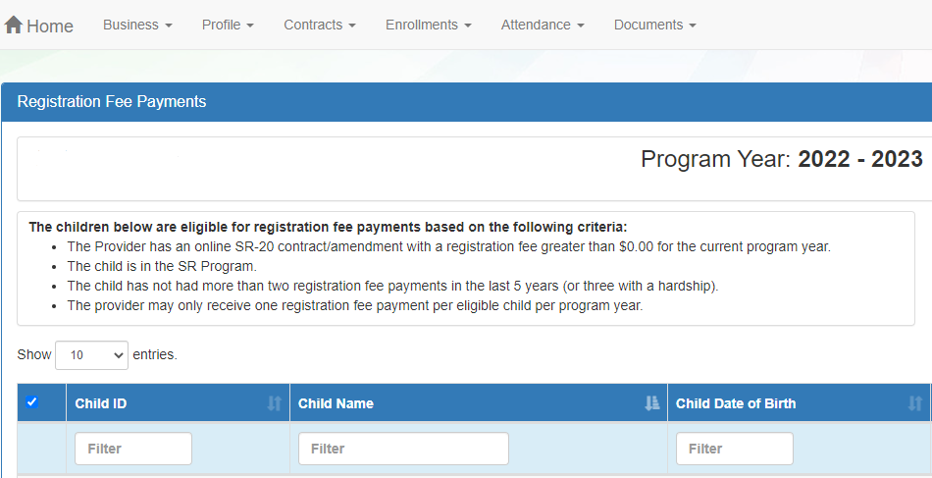
SR Registration Fee
Your program may be eligible to receive payment if you have listed that you charge parents a registration fee on your 2022-23 Profile and on your 2022-23 School Readiness Contract.​
Eligibility rules for Registration Fee payments
​The Provider has an online SR-20 contract/amendment with a registration fee greater than $0.00 for the current program year.
The child is in the SR Program.
The child has not had more than two registration fee payments in the last 5 years (or three with a hardship).
The provider may only receive one registration fee payment per eligible child per program year.
​
If your program has already collected the registration fee from the family, the child is not eligible for a Registration Fee payment and the child/children will need to be dismissed from the request.

Slide 27
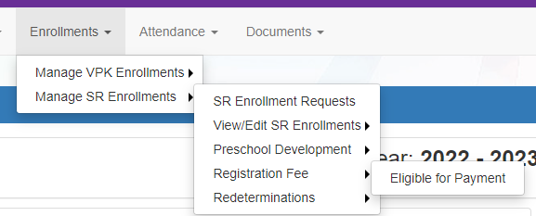
SR Registration Fee
Registration Fee Payments can only be requested by a provider through the Provider Portal. To request a Registration Fee, navigate to Enrollments -> Manage SR Enrollments -> Registration Fees -> Eligible for Payment
​
Request for payment will be due by the second business day of each month and will be paid monthly along with your School Readiness monthly payment.

Slide 28
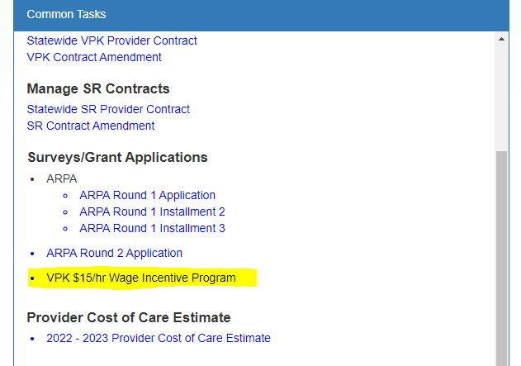
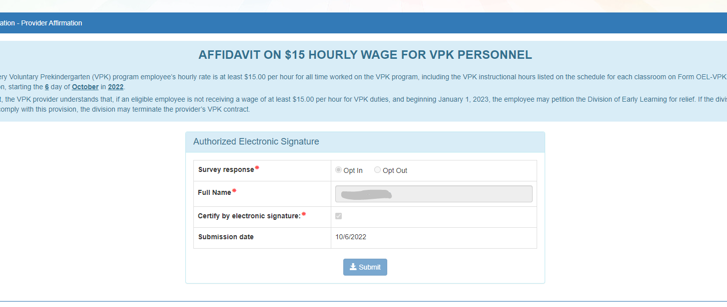
VPK $15 Wage Incentive
Within the application on the portal, each VPK provider will attest via
affidavit that every VPK program employee’s hourly rate is at least $15
per hour for all time worked on the VPK program within 30 days of
receiving the funds.
2022-23 School - Year Provider Rates
Baker- $1.10
Bradford - $1.09
Clay - $1.12
Nassau- $ 1.13
Putnam- $1.08
St. Johns- $ 1.15
School - Year Provider rates will be added to your VPK rate.
Located on home screen- common tasks
2023-2024 VPK $15 Wage Incentive is still up for deliberation within
Florida Legislature. We will let you know if it will be available for the
upcoming year.
​

Slide 29
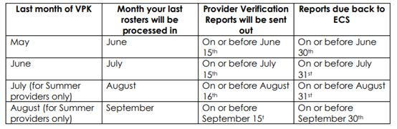
Provider Verification Reports
What is the VPK Provider Verification Process and when does it happen?
Per DEL policy, every VPK provider must verify the annual cumulative attendance of each child enrolled in their VPK program, which certifies the paid hours of attendance of each child enrolled for the program year. ECS may NOT pay any VPK provider their final payment of the program until this final verification is received. The Provider Verification reports will be sent out after we process your final month’s attendance rosters. The timeline for the 2022-2023 program year is:
​
Please also note that if you fail to notify ECS of any errors contained on the VPK Provider Verification Report, we are under no obligation to accept changes made to the KRR website during their Provider Verification Process.

Slide 30

Provider Verification Reports
Why do we have to verify all our children at the end of every year?
Each child’s attendance and how they are paid throughout the year is how we track whether or not they will count towards your Kindergarten Readiness Rate (KRR).

Slide 31

Reimbursement Department Staff
If you run into any issues or questions regarding Reimbursement, SR or VPK, please reach out to the Reimbursement Department at (904) 726-1500 ext. 7050.
Sidney Kostecki, Reimbursement Coordinator, ext. 2221
Christy Bramley, Reimbursement Specialist, ext. 2257
Courtney Cariveau, Reimbursement Specialist, ext. 2293
Darius Cannon, Reimbursement Specialist, ext. 2239

Slide 32
Questions?

Slide 33

Contract Department

Slide 34

Annual Provider Profiles
Between January 1 and May 31 of each calendar year Providers are required to update all information in the Provider portal. Profiles will be approved by ECS staff.
The 2023-24 Profiles are now available.
Reminder: Your 2023-24 Profile must be active before we can begin the process for contracting for SR & VPK.

Slide 35
Information Change Notification
XI. NOTIFICATION
Information Change Notification. PROVIDER agrees that it will comply with each of the following notification requirements:
a. Providing notice to the COALITION of changes in contact or program information within fourteen (14) calendar days.
b. Providing notice to the COALITION of a request for an additional program assessment in accordance with Rule 6M-4.740. PROVIDER acknowledges additional assessments are at the PROVIDER’s expense. The cost of the additional program assessment charged by the coalition: $425.00 .
c. Providing notice to the COALITION of temporary emergency closure by the close of business the first day that the closing occurs. Providing notice to the COALITION of subsequent reopening of the SR Program within two (2) business days of reopening.
d. Providing notice to the COALITION of permanent business closings or changes in business location or ownership must be reported at least thirty (30) calendar days prior to changes.
            This ensures that ECS can:
    1. Give parents the required 30-day notice.
    2. Request/Receive required documentation from Provider.
    3. Initiate a new contract (if needed)

Slide 36

VPK Summer Classrooms for 2023
If you plan on offering VPK for Summer 2023, please go to you 22/23VPK application and set up your summer calendar and summer classroom. You can add new teachers as you normally would or if it is an existing teacher that is Summer qualified you can use that teacher and just need to assign them to the Summer classroom.

Slide 37
Contract Department Staff
If you have any questions regarding Profiles or Contracts, SR or VPK, please reach out to the Contract Department at (904) 726-1500 ext 7054.
Sarah March, Contract Coordinator, ext. 2206
Roushawn Saunders, Contract Specialist, ext. 2241
Michele Yingst, Contract Specialist, ext.2167
Cameron Cline, Contract Specialist, ext. 2297
Melisha Farmer, Contract Monitor, ext. 2243

Slide 38
Questions?

Slide 39
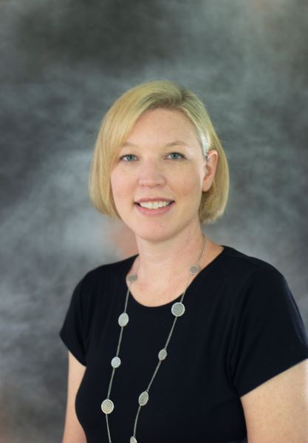
School Readiness
Education
Updates
Amanda Griffis Blair

Slide 40
SR Child Assessments
When completing your new SR contract, please note that the Child Assessments referenced are optional.
If your staff is not trained and certified as reliable in Teaching Strategies Gold, High Scope COR, or Galileo child assessment tools or your site is on a QIP, you will be ineligible to participate in these optional Child Assessments.
Please be sure to mark the correct response on your contract to avoid delays in contract approval.

Slide 41
ASQ/ASQ-SE Reminder
ASQ/SE completion will happen in the Family and Provider Portals.
Enrollment ASQs are completed by the parent/guardian at time of enrollment. Parent has the option to defer the screenings to the provider. If not completed within 5 days, the screenings will transfer to the provider for completion.
If the parent chooses for the provider to complete the ASQ and/or the ASQ-SE, coalition is required to ensure provider completes the screenings.
  If you completed a screening for a child and they are still showing as ‘incomplete’ in the Portal, it is likely due to the fact that the SE has not been completed. Click on that child’s screening again and complete the SE.
Failure to complete ASQs as required by Rule, will result in a Non-Compliance notice for your site.
  Every attempt to contact providers regarding incomplete/late screenings is case noted.

Slide 42
ASQ/ASQ-SE Reminder (Contd)
ASQs not completed by the families?
  Consider setting up a tablet or computer workstation for families and ask them to complete the ASQ within the portal during pick up or drop off time.
  We know these new changes have created some new issues and we are working hard to collaborate with OEL on possible fixes/solutions. We really appreciate your patience and understanding as we all learn to navigate this new system together.
  Please DO NOT back date ASQs. Use the current date you are actually completing the ASQs.
  Make sure you are using Google Chrome browser.

Slide 43
ASQ Screenings in Provider/Parent Portals
YouTube Video Tutorials
Family Portal
1.How to Complete the School Readiness Enrollment Process (5:50) https://www.youtube.com/watch?v=_QK7BDxYYM8
2.How to Complete Developmental Screening Questionnaires (6:32) https://www.youtube.com/watch?v=8WoGk-56J-s
3.How to View Screening Results (2:15) https://www.youtube.com/watch?v=s6SdVIiaWeI
4.How to Update Consent Settings (2:35) https://www.youtube.com/watch?v=eXxDziZfViI
Provider Portal
1.How to Complete and Submit Screenings (3:39) https://www.youtube.com/watch?v=vhVRhfs5pjU
2.How to Search for Screening Records (2:20) https://www.youtube.com/watch?v=2OAomM-XXP8
3.How to Add and View Screening Notes (2:39) https://www.youtube.com/watch?v=v0cT_0sbt6U

Slide 44
VPK CLASS Assessments
Per State Rule, ALL VPK classrooms will receive a CLASS assessment. All classroom scores will be calculated into one Composite VPK score for each VPK program. A score of 4.0 is required to continue to contract for future VPK programs.
Make sure your VPK teachers know what to expect! Ensure they have access to MyTeachstone accounts and/or have taken a PreK CLASS training.
Lead teacher listed in the Portal must be present for assessment to occur. Keep your portal profile updated!
We set up a tentative assessment schedule by month but as we’ve stated before please know that your assessment month assignment is *tentative* based on many factors. Your assessment may be moved up earlier in order for our agency to ensure all assessments are completed as required by DEL.

Slide 45
CLASS Assessment Reminders:
Continue your normal schedule during assessments. Children respond best to their normal routine and structure.
Outdoor time for Infants and Toddlers will be assessed. Pre-K can be assessed if there is a structured activity planned. Let your assessor know ahead of time whether outside time activities are planned.
Dual Coding- as we build assessor capacity, train, and set measures to ensure CLASS reliability, please note that 2 assessors may be present for your assessment(s).
Due to the high volume of CLASS assessments required this year, we cannot guarantee that assessments will occur for each site during the same time frame as previously scheduled.

Slide 46
CLASS Assessment Reminders (continued):
Assessors are coached by supervisors to give no feedback regarding assessment scores after each assessment. Providers are required to request, in writing, for their individual classroom notes. Information on this is provided in the email you’ll receive notifying you of your composite score(s).
If you open a VPK room after your CLASS assessments have taken place, the new class will be observed, and your VPK assessment composite score will be recalculated.
If your composite score for SR and/or VPK are below 4.0, provider has the option to pay $425 per classroom re-assessed to try to qualify for contracting eligibility. If you open a new classroom before your reassessment, you will be required to pay for all required classrooms to be re-assessed (this is in state Rule).

Slide 47
SR CLASS Training/Resources
It is extremely important for teachers to receive on-going CLASS training. Please do not assume that your center will receive a score similar to your last year’s score if your teachers have not continued to train on CLASS.
  CLASS strategies and scoring are very specific. Directors should have a training plan in place for seasoned teachers as well as new teachers
Be sure to take advantage of the FREE MyTeachstone accounts we have been advertising. This resource has a library of information, courses, and videos on every area of CLASS in each of the 3 age ranges (Infant, Toddler, PreK).

Slide 48
MyTeachstone Accounts
If you would like to sign up yourself and your teachers for an account you can reach out to your assigned Education Specialist, Amanda.Griffis@ecs4kids.org for SR and Ashley.Rich@ecs4kids.org for VPK Only sites.
Send a list of first and last names and an individual email address.

Slide 49
Exemptions for SR CLASS
  Exempt providers- can remain exempt unless site receives qualifying DCF violations and/or SR enrollment exceeds the 20% SR enrollment threshold.
  Biannual providers- if you received a composite score of 5 or above last year, your assessment will be skipped this year unless your site receives qualifying DCF violations and/or site does not retain 80% of teaching staff throughout the year.
    NOTE: Biannual statuses expire on June 30th. Starting July 1, 2023-ALL previously biannual programs will receive CLASS assessments regardless of scores received this year.
No exemptions for VPK classrooms.

Slide 50
Other CLASS Learning Opportunities
Check the ECS training calendar:
https://ecs4kids.gosignmeup.com/Public/Course/Browse
Check the Early Learning Florida Training Calendar
https://www.earlylearningflorida.com/catalog
Read the ECS Helping Hands Monthly Newsletter
  Includes CLASS strategies in the activities
Read the Book of the Month activities/ Watch the BOM videos
  Includes CLASS strategies in the activities
  Posted to “ECS In The Know” Provider Facebook Group
Visit the Teachstone website for products to use in the classroom
https://teachstone.com/
Reminder: For providers who received the CLASS strategy cards and CLASS dictionary- be intentional about using these materials in the classroom.
Directors- ensure lesson plans are being created with CLASS strategies in mind, complete informal CLASS strategy observations; create training plans for each staff member that include formal and informal CLASS training

Slide 51
Quality Performance System Staff Rosters for SR Providers
Staff rosters must be updated and submitted monthly (by the 20th of each month).
Staff rosters and CLASS registration are separate requirements. If you receive an email to complete registration for CLASS assessments, you must complete the registration and make sure your roster is complete and submitted.
Family Child Care providers must also submit staff rosters, even if there is only 1 staff member (themselves).

Slide 52
Questions?

Slide 53
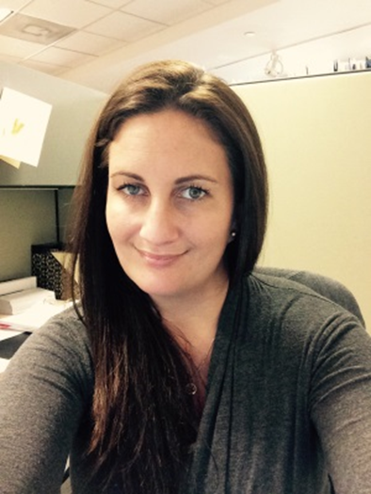
Grant Updates
Brittney Spangler

Slide 54


AVAILABLE GRANTS
Workforce Grant
ARPA
This Photo by Unknown Author is licensed under CC BY-SA

Slide 55
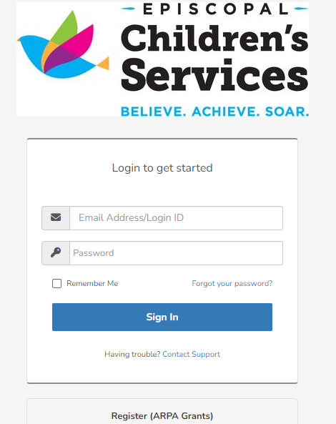
Workforce Grant: Important New Application Process Effective 03/13/23
Go to the following link:
https://elcecs.webauthor.com
Owners/Directors please register for an account
through ARPA module at the link listed above.
2. If you have already registered, you can simply
sign in by clicking on the blue button and use
the information provided during the registration
process.
3. When registering, you will be prompted to enter
your information such as your name, email
address, and reason for registering.
Please enter: Apply for ARPA Grants in the registration
reason box & then click register.
REGISTER

Slide 56
Workforce Grant Continued
You will receive an automated message letting you know that your account has been approved
& you will be able to log back into your account & create a profile for your
school/program.
Once logged back in, the first step will be to click the blue button that says New Eligibility
Request in the screen. It will take you to an application where you will enter the information
for your school. If you already have a current provider profile through the statewide portal,
then your school information should prepopulate for you without you having to fill in
everything.
Once you submit that first initial application, our coalition will review that application.
Upon approval you will gain access to apply for any of the workforce grants based upon
eligibility requirements.
If you receive multiple rejections & need assistance with registering for an account or a particular application, please reach out to the workforcegrants@ecs4kids.org to schedule a virtual meeting to help walk you through the process.

Slide 57
Arpa grants
1 & 2

Slide 58
ARPA Grant Deadline Changes
(Through Provider Portal)
ARPA Round 1
ARPA Round 2
Initial Application Expired June 30, 2022
Round 1, Second Installment Survey
Submission Expired – December 15, 2022
Approval in EFSM Expired – December 30,2022
Payments Expired – January 31, 2023
Round 1, Third Installment Survey
Submission – April 3, 2023 April 5, 2023
Approval in EFSM – April 17, 2023 April 19,2023
Payments – May 17, 2023
Submission Expired - February 28, 2023
Approval in EFSM – April 5, 2023
Payments – May 5, 2023
Total award will be paid in one payment

Slide 59
New Dates for Final Payments - ARPA
The amount of this final payment for approved Round 2 providers will be determined by DEL on a proportional share of remaining ARP Stabilization funding, less coalitions’/RCMA allowable administrative allocations (up to 5% of ARPA expenditures).
Providers must complete a final survey to qualify for the final payment.
The deadlines for the final payment survey are as follows, unless otherwise notified by DEL:
Release in EFSM – April 5, 2023 April 27, 2023
Submission – April 19, 2023 May 11, 2023
Approval in EFSM – May 3, 2023 May 25, 2023
Coalitions notified of final payment amount – May 17, 2023 June 15,2023
Payments – May 31, 2023 June 30,2023

Slide 60

Provider Reporting ARPA Round 1 and 2
Providers are required to continue reporting expenditures until all ARPA Child Care Stabilization Subgrant – Round 1 and 2 funds are spent.
All funds must be spent no later than September 30, 2023.
Final funds utilization reports are due October 31, 2023.
Providers failing to submit expenditure surveys may be required to repay any unspent funds.
The ELC of North Florida/Episcopal Children’s Services are required to make and document efforts to obtain close-out expenditure spending when a provider ceases operations with an outstanding balance.
Guidance Available:
Sample Budget Tracking
Child Care Stabilization Spending Documentation Guide
Child Care Stabilization Subgrant Provider FAQs – 10/28/2022
Email Contracts@ecs4kids.org and ask for the documents listed above for assistance with allowable costs and how to track funds spent.

Slide 61

Florida’s Assessment of Student thinking (FAST)
USING STAR EARLY LITERACY

Slide 62
What is FAST?
Florida's Assessment of Student Thinking (FAST) using Star Early Literacy
The Coordinated Screening and Progress Monitoring Program is the statewide, standardized program known as Florida's Assessment of Student Thinking (FAST) using Star Early Literacy implemented in all VPK programs as required by s. 1002.68, F.S., that is used to assess student achievement of the performance standards established in s. 1002.67(1)(a), F.S., in early literacy and mathematics.
VPK Programs (school-year and summer) will begin implementation of the FAST using Star Early Literacy beginning in the 2022-2023 VPK Program Year.

Slide 63
FAST Implementation
VPK Programs are required to administer the assessment three times within its program and must be administered by a qualified test administrator. (PM1; PM2; PM3)
The assessment shall be administered individually or in a small group with no more than five students.
The assessment shall be administered on a touchscreen device. Student headphones shall be used when administration occurs in group sizes of two to five students.
Testing accommodations shall be made in accordance with a student’s current Individual Educational Plan (IEP) of 504 Plan issued by the local school district.
VPK Programs are required to provide a student’s performance results from the assessment to the student’s parents within seven calendar days after the administration of the assessment. VPK Programs must provide the Star Parent Report. The Star Parent Report provides a printable informational letter for parents or guardians and is available in English and Spanish. This is currently NOT being collected by ECS but may be requested at a later date for monitoring purposes. The link to running instructions can be found here: https://help2.renaissance.com/reports/25027.

Slide 64

Florida’s Assessment of Student Thinking (FAST) using Star Early Literacy (Cont.)
Rostering
VPK Program Administrators will need to ensure that their Provider Portal is up to date prior to the VPK Program year beginning and throughout the year. The Division of Early Learning (DEL) will send nightly files to Renaissance generated from the DEL Provider Portal. The files will include students enrolled in VPK and information about classrooms and instructors. This allows the Renaissance system to setup the site for VPK Programs to administer the Star Early Literacy Assessment. This also includes adding any new or reenrollment children throughout the program.
All program changes must be made in the Provider Portal and may take up to 48 hours to reflect in the Renaissance site. Changes cannot be made in the Renaissance site.

Slide 65
Florida’s Assessment of Student Thinking (FAST) using Star Early Literacy
Progress Monitoring (PM) Periods
Progress Monitoring 1 (PM1): Is the first thirty (30) instructional days of the VPK class schedule beginning with the first VPK instructional day.
Progress Monitoring 2 (PM2): Is the period of time in a VPK class schedule where at least 40% of the instructional hours have been completed and no more than 60% of the instructional hours have been completed. PM2 IS A REQUIREMENT FOR VPK
Progress Monitoring 3 (PM3): Is the last thirty (30) instructional days of the VPK class schedule ending on the last VPK instructional day.
Please remember that your testing window dates may change if you have any calendar changes.
If you accidently test outside of your classroom’s testing windows, you will need to retest the children during your testing windows in order to be in compliance with the VPK contract.
If you test a child more than once in your testing window, DEL will use the first test administered for that Progress Monitoring period.
Periodically we are updating our website with current Progress Monitoring Dates for each ELC of North Florida VPK Provider at the following link: https://www.ecs4kids.org/programs/vpk/providers/

Slide 66

FAST - Non-Participation Statuses
Assessment Inappropriate- For students that are Blind/Visually Impaired, Deaf/Hard of Hearing, Medical Exemption Accommodation that can’t be met with computer-based test (IEP/504 requiring Paper Based Test). The Star Early Literacy Assessment may not be appropriate for all VPK students. If you have a student with an Individual Educational Plan (IEP) or 504 Plan and the VPK Program Administrator determines this assessment will not meet the student’s needs, the student should receive a Non-Participation Status of “Assessment Inappropriate.”
Failed Practice- For students who failed the practice items after three attempts. The Star Early Literacy Assessment Practice Items should be administered to all VPK students unless the student has been given a Non-Participation Status of the Assessment Inappropriate and students should be given at least three attempts to pass the items. If a student continues to fail the items, the student should receive a Non-Participation Status of “Failed Practice.”
Not Present During Testing Window- For students absent during the entire Progress Monitoring period. The Star Early Literacy Assessment dates should be provided to VPK student families, to ensure their child’s attendance on testing days.
Non-English Speaker- For students with a first language other than English who are unable to pass the practice items after three attempts. The Star Early Literacy Assessment is only administered in English. All students with a first language other than English should be given the opportunity to complete the practice items, if they pass, they continue and complete the assessment. They should be given two additional attempts to pass the practice items. If the student fails the practice items, then the student should receive a Non-Participation Status of “Non-English Speaker.”

Slide 67
FAST - Non-Participation Statuses (Cont.)
Each child should attempt to take the assessment three (3) times before being marked in a Non-Participation Status
Children marked as non-participation are still showing as children not tested on Renaissance reports.
Currently, reports are not available to show a list of these children.
For monitoring purposes, ECS is asking for providers to run the STAR TEST ACTIVITY REPORT and upload it to the Provider Portal - Document Library in the appropriate STAR Early Literacy PM1; PM2: PM3 Folders.
Before uploading, please review the report and any children that are listed as NOT TESTED, please note next to the children’s names the reason they were not tested.

Slide 68
FAST Training Requirements & Options
To be qualified as a test administrator, an individual must be employed by a private VPK provider or school district; and complete, and document completion of, professional development training that is designed to ensure the proper administration of the assessment. Summer 2022 Webinar training sessions have concluded. VPK Program Directors Training Schedule click here and the VPK Program Instructors Training Schedule click here.
For anyone that needs to complete the training requirements can do so through Renaissance-U, using the: FAST Star Early Literacy Renaissance-U Enrollment Guidance.
Additional Training through Renaissance
Smart Start and How-to Webinars are additional resources for Star professional learning. These resources can be accessed using the links below and through Renaissance-U. To access Renaissance-U, log into your Renaissance platform and select the Renaissance-U tile.
Smart Start is your self-guided journey through Star. Explore introductory videos and resources to help you master basic navigation and essential best practices. Use your students’ Star results to plan personalized instruction in three initial steps. You’ll be introduced to administering the test, using data from screening to group students, accordingly, and gleaning insights from the program to inform instruction.
Smart Start Link: https://renaissance.widen.net/s/lxl77bvw52/smart-start-landing-page_210318

Slide 69
FAST TRAINING Confirmation
Onsite or Zoom
Participants that attended VPK FAST Training over the summer onsite or via Zoom and completed training and do not see it on their DCF transcript, will need to email VPKFAST@del.fldoe.org the following information:
  First and Last Name
  Email Address (used to login to DCF account)
  DCF Student ID
  Session Type (Onsite or Zoom)
  Session Date and Time
Many did not register with correct information and/or did not provide DCF ID at all. Information must match 100% with DCF to be imported on transcripts.
If there is a name change the individual must provide legal documentation to DCF. So far, there are 7,400 successful imports on transcripts. Zoom and OnSite participants must email vpkfast directly to verify training and DEL will send to DCF.
Renaissance-U
Participants that have completed the training through Renaissance‐U that DCF has been unable to import on transcripts will be emailed directly with next steps.
Updated information from Ren U is sent to DCF on weekly basis. It will take at least one week to show on transcript once profiles are updated.

Slide 70
FAST/Renaissance Resources & Support
Resource Website
VPK Program Administrators should be familiar with the VPK FAST website as information and resources are updated frequently, linked here: https://www.floridaearlylearning.com/vpk/fast.
Several resources have been added & this will your best resource for up-to-date FAST information.
Contact Information
Renaissance System Support: Users who need Renaissance System support should contact the Renaissance Place Help Desk and Technical Assistance Team at 1-800-338-4204 or by completing this NEW form (https://www.renaissance.com/request-support/) or a Renaissance representative.
Policy Questions? Contact the Division of Early Learning with questions related to FAST using Star Early Literacy implementation requirements. Select which best describes who you are: VPK Provider or VPK Parent and your information and questions will be submitted to the Division of Early Learning.
https://www.floridaearlylearning.com/vpk/fast/fast-vpk-providers-form

Slide 71

Provider payment rates

Slide 72


Provider Payment Rates
The ability to set provider rates transitioned from the local Early Learning Coalition to the State of Florida as of July 1, 2022
There is no rate increase expected in the next year.
If the State does a rate increase in the future, they will look at the private pay rates providers in each county have entered into the portal under their profile.
This means it is extremely important that you do not discount the rates you give us. If you feel that some families may not be able to pay your full rate, it is better to offer them a discount rather than understate your rates in the portal. Doing so, hurts you and all providers in your county in the long run.

Slide 73
Questions?

Slide 74
SR Provider Survey
You will receive an email with the link to a survey. Please take the time to fill this out. We use your feedback to guide future Provider Meetings☺ THANKS!!!

Slide 75

More Questions
Amanda Griffis Brittney Spangler
(904)726-1500 x 2255 (904)726-1500 x 2229
Amanda.griffis@ecs4kids.org brittney.spangler@ecs4kids.org
Ashley Rich Shanda Ellis Shivaughn Williams
(904)726-1500 x 2274 (904)726-1500 x 2253 (904)726-1500 x 2283
Ashley.rich@ecs4kids.org shanda.ellis@ecs4kids.org Shivaughn.williams@ecs4kids.org

