Slide 1
Notes:
Welcome! We are so excited that you’re here with us today.
Throughout this short presentation, we will talk about the important role that you play in your child’s development and introduce easy-to-use ways you can support that development using one simple tool: the 3Ts! So let’s dive in.

Slide 2
What are the 3Ts?
The 3Ts - Tune In, Talk More, and Take Turns - a simple, yet powerful tool to help parents make the most of everyday interactions with their children.
Notes:
Since talk and interaction are so important, how do you make the most of every moment with your child?
Use the 3Ts: Tune In, Talk More, and Take Turns.

Slide 3
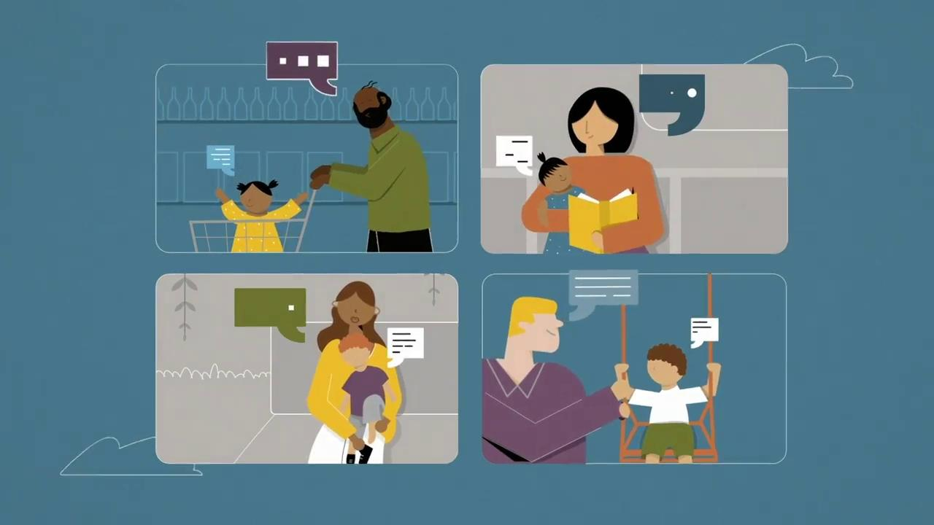
Notes:
Play video

Slide 4
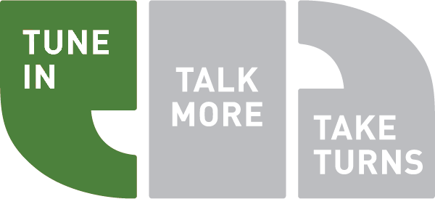
The 3Ts
Tune In: Be in the moment with your child.
Use what your child is focused on to guide your interactions.
Children’s focus is always changing, so it’s important to stay Tuned In.
If you aren’t Tuned In, you won’t be able to Talk More or Take Turns.
Notes:
Let’s take a closer look at each of the 3Ts.
Tune In means be in the moment with your child and notice what your child is focused on.
When you Tune In to your child, you use their cues to determine what they’re paying attention to and talk about that. Use what your child is focused on to guide your interactions.
Children’s focus is always changing, so it’s important to stay Tuned In.
Tune In is the first step to engage your child in rich interaction. If you aren’t Tuned In, you won’t be able to Talk More or Take Turns because you and your child will be focused on different things.

Slide 5
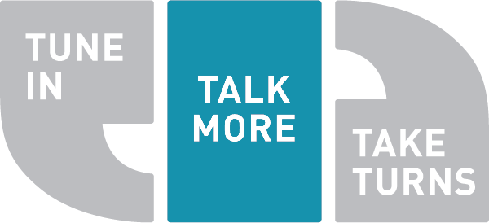
The 3Ts
Talk More: Use a wide variety of words.
Expose your child to a rich language environment.
Think of your child’s brain like a piggy bank. Every word you say is another penny in the bank.
Children learn best when you Talk More with them.
Notes:
Second, Talk More means use a wide variety of words.
The goal of Talk More isn’t to teach your child sight words or read to them from the dictionary. It’s to surround your child with rich language.
Think of a child’s brain child’s like a piggy bank. Each word you say is a penny in their bank. The more you talk, the richer your child gets.
But Talk More isn’t just about the quantity of words. It’s about ensuring that your child hears more words in conversation with you.
While some children may pick up things from overhearing adult conversations or watching educational television, they learn best when you Talk More with them.

Slide 6
Notes:
Play video

Slide 7
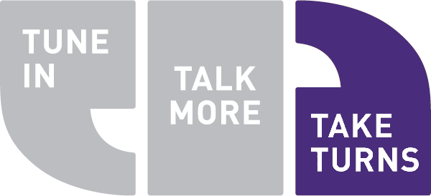
The 3Ts
Take Turns: Engage your child in conversation.
Take Turns means listening and responding to their communicative attempts.
The way a child Takes Turns will change as they grow.
The more they Takes Turns, the more they learn.
Notes:
Finally, Take Turns means engage your child in conversation.
Take Turns does not mean sharing or asking your child to do something after you’ve done it.
Rather Take Turns means listening and responding to your child’s attempts at communication, and giving them space to contribute in whatever way is developmentally appropriate.
A baby may Take Turns through eye contact, babbles, body movement, or cries. As a child gets older, their turns become made-up words, words, and eventually sentences.
The more they Takes Turns, the more they learn.

Slide 8
Use all 3Ts at once to build the strongest possible brain for your child.
Notes:
Some parents say:
“The 3Ts sound great! I’ll pick my favorite and try to use it at least once a day.”
Actually, the 3Ts are designed to be used all at once. There’s no need to pick just one. When you Tune In, Talk More, and Take Turns, you build your child’s brain, and make the greatest investment you can in their future.

Slide 10
The 3Ts don’t cost anything, and they don’t require extra time or special training.
They can be used anytime, anywhere to build your child’s brain.
Notes:
The best part about the 3Ts is that they are designed to be simple for a busy parent to use. They don’t take extra time, expensive materials, or special training. They truly can be used anytime, anywhere to build your child’s brain.
Now let’s take a look at some examples of how parents can use the 3Ts to make the most of every interaction with their children.
Today we’ll use daily routines, playtime, meal time, and storytime as examples, but there are so many other opportunities throughout your day when you can use the 3Ts. As you watch these examples, think about other ways to build them into your day.

Slide 11
Within every parent lies the ability to build their child’s brain.
When you Tune In, Talk More, and Take Turns you make the greatest investment you can in child’s future.
Notes:
Within every parent lies the ability to build their child’s brain.
When you Tune In, Talk More, and Take Turns you make the greatest investment you can in your child’s future.

Slide 12
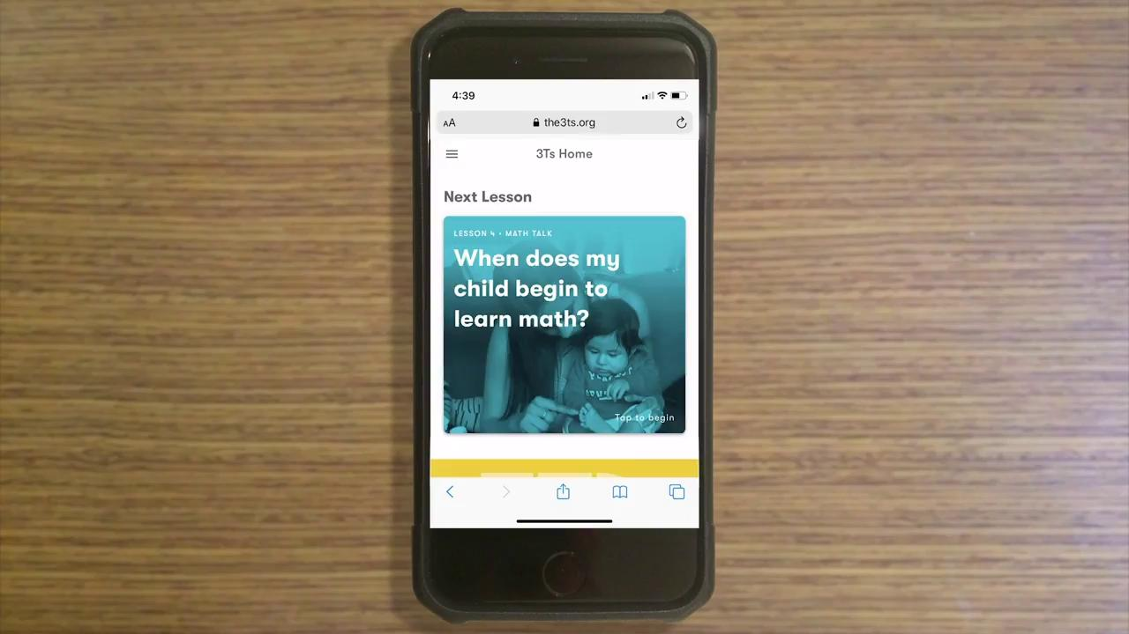
the3Ts.org
Notes:
Interested in learning more about the 3Ts, or sharing them with others? Check out the3Ts.org, a free web app that contains 3Ts lessons, videos, and interactive activities to help you support your young child’s development.
Play video

Slide 13
For more information about 3Ts
contact Michele Goytia-
Childcare Resource and Referral Coordinator at (904) 213-3939 x2082 or at email michele.goytia@ecs4kids.org

Slide 14
Thank you!
Notes:
Thank you for being here! We hope that this offered you some new ways for you to continue to support your child’s healthy development. Please stop at the Any Time is 3Ts Time table on your way out to pick up some 3Ts resources and be sure to ask one of our staff if you have any other questions about what you learned today.

