Slide 1
Welcome to the ECS January 2021 Provider Meeting
(we will begin at 1pm)
Clay
Nassau
Baker
Bradford
Putnam
ST Johns

Slide 2
THANKS FOR JOINING!
Please make sure your microphones are muted
If you have questions or comments please type them in the chat box and we will review them at the end of each section
As always, this meeting will be recorded, and the recording will be sent out afterwards via blackboard

Slide 3
Meeting Agenda
3 T’s with Michele Goytia
Family Services Updates
Reimbursement Services Updates
Contract Updates
School Readiness Education
Questions

Slide 4
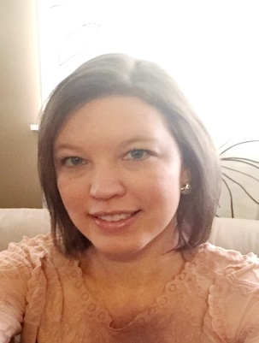
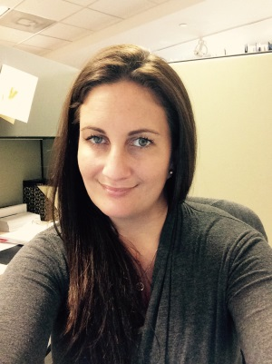
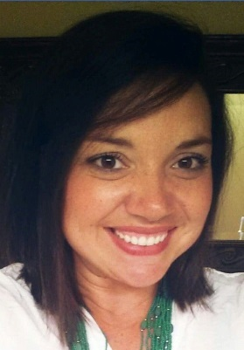
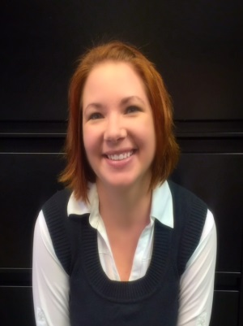
WELCOME Meet Our Staff
Director of School Readiness Education Senior Director of Programs
Amanda Griffis Brittney Spangler
Manager of School Readiness Education Manager of Family Services Director of Provider Services
Ashley Rich Shanda Ellis Alicia Williams-Baltzell

Slide 6
What is 3Ts?
Tune In: Be in the moment.
Talk More: Use a wide variety of words.
Take Turns: Engage your child in conversation.
The 3Ts don’t cost anything or require extra time in the day.
They can be used anytime, anywhere to build a child’s brain.

Slide 7
3Ts: Tune In, Talk More, Take Turns
Any Time is 3Ts Time aims to create broad awareness of foundational brain development across communities and a deep knowledge shift within parents in order to help all children succeed. It includes online, print, and in-person resources that help caregivers support their young children’s brain development, particularly in the first 3 years of life.
This Photo by Unknown Author is licensed under CC BY-NC

Slide 8
3Ts is 7 Strategies that any parent or caregiver can complete online at the3ts.org .
The strategies are concise and easy to complete.
For providers in addition to the 3Ts strategies, the TMW Center is providing unrestricted access to the TMW–Early Childhood Educator, their free online professional development course.

Slide 9
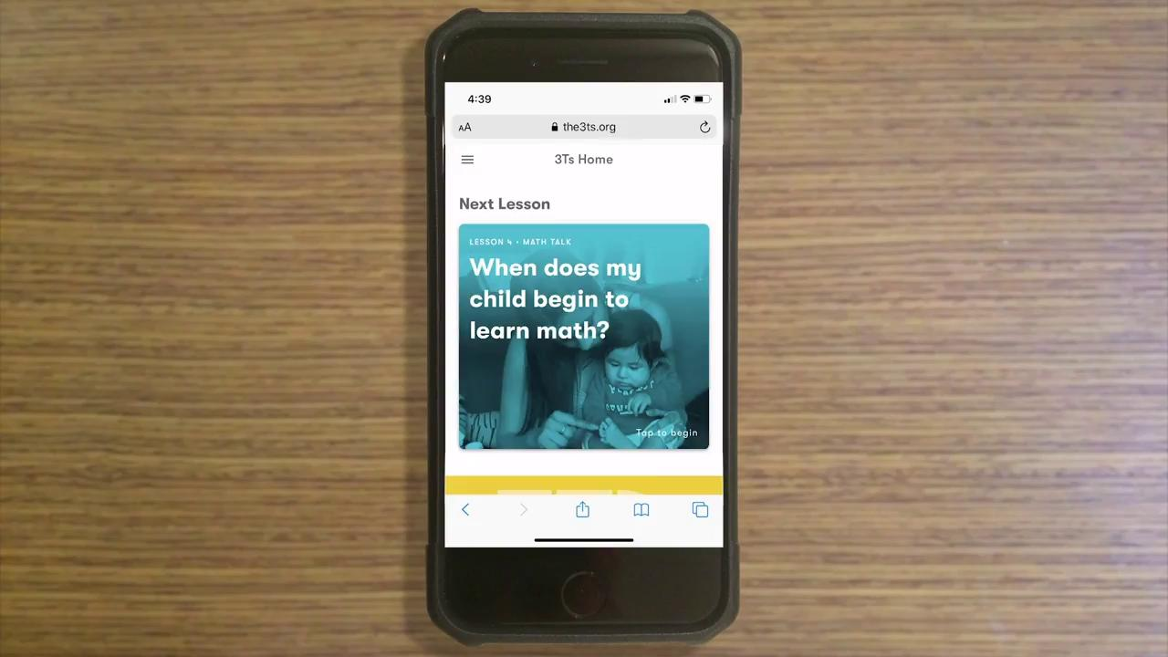
the3Ts.org

Slide 10
TMW–Early Childhood Educator Course
A series of 8 self paced modules
They focus on how caregivers of 0-to-3-year-olds can the 3Ts to support children’s foundational brain development.
Can be used as continuing education.
To enroll, visit: https://redcap.uchicago.edu/surveys/?s=PXDDPLF3XA

Slide 11
For more information about 3Ts
contact Michele Goytia-
Childcare Resource and Referral Coordinator at (904) 213-3939 x2082 or at email michele.goytia@ecs4kids.org

Slide 12
Family Service Dept. Updates

Slide 13
One Stop Office Staff:
Baker, Bradford, Nassau & Putnam
Clay, St Johns & Central
Baker- Eryss Meguia 904-259-4255
Bradford- Vickie Hancock 904-964-1543
Nassau- Mary Catherine Quigley – 904-432-0009 ext. 2626
Putnam-
Christina Jackson – 386-385-5450 ext. 2884
Emily Taylor – 386-385-3450 ext. 2881
Coordinators-
Diana Alvarez – 904-770-2565 ext. 104
Shecovia Grimes – 904-725-1500 ext. 2290
All email addresses are firstname.lastname@ecs4kids.org
Clay-
Courtney Edmond – 904-213-3939 ext. 2081
Jacki Chimino – 904-213-3939 ext. 2081
Leatricia Ahmadu – 904-213-3939 ext. 2039
St Johns
April Florida – 904-770-2565 ext .105
Brandi Harrison – 904-770-2565 ext. 101
Central
Shalanda Hall – 904-726-1500 ext. 2263
Florine Reeves – 904-726-1500 ext. 2273
Please keep in mind, the majority of the time we are working remotely from home. If you get our voicemail, please leave a message!

Slide 14
VPK Child Applications
VPK Child Applications for the 2021-2022 VPK Program Year opened in the Family Portal on January 1, 2021.
Family Services Specialists are working in the VPK Child App submitted queue daily for both the 2020-2021 and 2021-2022 program years.
Reminder that any family transferring from one provider to another provider must apply for the reenrollment through their family portal account.
If you have a family that states it is has taken more than 2 weeks to be either approved or rejected for their VPK child application, please have the family call 904-726-1500 ext. 7055
We cannot approve a transfer if the child is still enrolled in the original provider’s program. Please remember you should always look at the approved Certificate of Eligibility issue date to verify when eligibility starts for the child.
This Photo by Unknown Author is licensed under CC BY-SA

Slide 15
SR Wait List
Normal qualifications to qualify for the wait list are that the client must meet one of the following: work a minimum of 20 hours a week, be in school as a student, or, be listed as permanently or temporarily disabled as noted by social security awards letter or a letter from a doctor.
Through March 31, 2021 a family can apply to the waitlist and qualify for funding even if they are not working/going to school or do not meet the minimum hours worked for a household.
We are currently sending out funding notices every other week for all six counties. Once we reach the enrollment threshold needed, we will stop funding notices.
Please encourage your families to apply to the waitlist while funding is available and especially while there is a waiver for qualifying without having to meet the normal qualifications listed above!

Slide 16
Waiting List Qualifications Through March 31
1. Job search and employment and/or education activity totaling less than 20 hours per week meets purpose for care requirements for placement on the waiting list.
2. The requirement to submit supporting documentation for families with job search as a purpose for care is waived for purposes of placement on the waiting list.
3. This applies to families applying for the waiting list through March 31, 2021.
4. If the family receives a funding notification after March 31, 2021, job search and reduced hours will no longer be an acceptable purpose of care. The family will need to meet the eligibility requirements in Rule 6M-4.200, F.A.C.

Slide 17
SR Wait List Continued
Clients apply for the wait list through the family services portal. Once the application is received, they will receive notification within 10 days from the date that they submitted as to whether they qualify or not. They must apply for services in the county they reside in.
Once placed on the wait list they will remain there until funding becomes available or 6 months redetermination at which time, they would just upload a new supporting document showing they still qualify and resubmit. (Currently, we are sending funding notifications out every other week to all six counties, and through March 31, parents do not have to be working or going to school to qualify.)
When funding notices are sent out, they are sent to Priority 3 or non-school age and siblings under the age of 9. If a family has a child that is 9 or older that child remains on the wait list as those children are under a different priority. School age only children are the last group that receive notifications due to their priority being lower.
As of now, the waiver is only good for funding notices received on or before March 31, 2021 to qualify without a purpose of care. After that, families will need to meet the eligibility requirements listed on the first slide.

Slide 18
ESS Referral Phase Out
Starting January 1, 2021 referrals will phase out with their expiration dates. The following will factor in on whether the client continues to receive SR services or not:
If a family previously submitted paystubs and all other household income received, the documentation will be reviewed to determine if the household income falls within the eligible household income guidelines. If the income is over the eligible income requirements for the School Readiness Program, services will end on the last day of the referral. This will be noted in a 14-day termination notice.
If the income previously provided is within the eligible income guidelines, services will continue under the School Readiness Program, unless the client informs us otherwise that they choose not to participate in this program.
If the client has not already submitted paystubs and all other household income, they will be given 3 months from the time your referral ends to provide this documentation. This will be noted in a 14-day termination notice of the referral ending date. During this three-month period, services will continue under the School Readiness Program unless the client informs us that they would like to terminate services prior to the end of the 3-month period.

Slide 19
Eligibility without a Purpose of Care (POC)
Families can establish initial eligibility with purpose for care as job search or less than 20 hours of an employment and/or education activity through March 31, 2021. Families issued a funding notice through March 31, 2021 may use job search or reduced hours for initial eligibility. After March 31, 2021, families must meet the eligibility requirements in Rule 6M-4.200, F.A.C.
The job search and reduced hours eligibility provisions also apply to redetermining families through March 31, 2021. Families issued a funding notice through March 31, 2021 may use job search or reduced hours for redetermination. After March 31, 2021, families must meet the eligibility requirements in Rule 6M-4.200, F.A.C.
Upon receipt of a funding notification, these families will have 60 days to submit documentation to support job search as purpose for care or validate a reduction in employment due to COVID19.
Examples of documentation for job search include submitted application for reemployment assistance, receipt of reemployment assistance or a completed job search form used for reemployment assistance services from the Department of Economic Opportunity (DEO).
Examples of documentation for a reduction in hours include employer verification or paystubs showing a reduction in hours due to the COVID 19 pandemic. Documentation the parent is furloughed or on temporary layoff as defined by DEO is also sufficient to establish purpose for care with less than 20 hours of employment and/or education activity.

Slide 20
Eligibility without a POC Continued
Families that qualify for School Readiness with “job search” as a purpose for care will be authorized a 12-month eligibility period and will be given 3 months at the beginning of the authorization period to establish a purpose for care.
Families that qualify for School Readiness with less than 20 hours of work and/or education activities will be authorized a 12-month eligibility period and will be given 3 months at the beginning of the authorization period to re-establish the minimum number of work and/or education hours to meet purpose for care as a working family.
Families shall be authorized either part-time or full-time care depending on the needs of the family. Examples of factors to be considered are how much time the parent indicates they need to search for a job or whether their employer requires them to be available full-time hours.

Slide 21
Pending Family Acceptance (PFA) Enrollments
Starting in March 2021, OEL will be enforcing signing of the payment certificate to process attendance to receive reimbursement.
New enrollments and redeterminations that begin in March 2021 will not be able to be viewed on your roster or submitted for payment until the payment certificate is signed by the family. Once the certificate is signed, providers will be able to submit the attendance for payment but may have to wait until the next processing period to submit the attendance if the processing period has already closed.
To help providers with this process, starting in late January, early February families will receive a system generated email from the Family Portal every five days until the certificate is signed.
Exceptions:
New Pending Family Acceptance (PFA) enrollments with BG1 or BG3R billing group. Both new and previous enrollments in these billing groups will always be able to be paid as they are must serve clients.
Existing Pending Family Acceptance (PFA) enrollments that have already been submitted for attendance in prior months. These will be grandfathered in. Providers will still be able to process attendance and be paid for these enrollments.

Slide 22
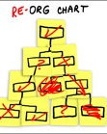
Family Services Restructuring
Beginning in January 2021, the Family Services Staff have started working what we call “Cross County”.
All One Stop Offices are still open; however, you may see that Family Services Specialists (FSS) that may not work in your particular county office are helping your family with their SR services.
By having the ability to work cross county in the Statewide Portal, we are hoping to be able to work more efficiently through records being submitted in the portal.
With the Covid pandemic, the State pushed records back from having to be redetermined helping families through this hard time. However, now that redeterminations are coming back in there is a backlog of families needing their services updated. By having each FSS be able to work through the submitted queue regardless of the county the parent lives in we hope to be able to move more records in a consistent manner through all of our counties whether big or small!
Please bare with us as we work through the ins and outs of all the many moving parts of the School Readiness eligibility updates and the continuing movements of waivers as the State updates them.

Slide 23
Family Service Dept. questions?

Slide 24
Provider Services Updates

Slide 25
Provider Services Updates
This Photo by Unknown Author is licensed under CC BY-NC-SA

Slide 26
Reimbursement Services Updates

Slide 27
Support for School Readiness and VPK Providers: COVID-19
Open SR Providers - Beginning in January, SR Providers will be paid according to rule 6M-4.500 Child Attendance and Provider Reimbursements and will be reimbursed for up to 10 total absences (3 excused and up to 7 with documentation).
Beginning in January, co-payments are no longer waived and should be collected by the provider.

Slide 28
Support for School Readiness and VPK Providers: COVID-19
Open VPK Providers - VPK Providers will be reimbursed according to the “80/20 rule” consistent with the VPK contract. This means that you will be reimbursed 100% for students that attend at least 80% of the month.

Slide 29
SR Registration Fees
Your program may be eligible to receive payment if you have listed that you charge parents a registration fee on your 2020-21 Profile and on your 2020-21 School Readiness Contract.
The following eligibility rules for Registration Fee payments also apply:
Children are/were enrolled during the 2020-2021 program year.
Children’s registrations fees have not been paid more than 3 times in 5 years to any childcare provider (excluding payments from 2019-2020).
Children with the BG1-ESS billing group and eligibility code are not eligible.
Children enrolled 3 months or less with expulsion reasons (Safety of Other Children or Behavior Problems) are not eligible.

Slide 30
SR Registration Fees (cont.)
Registration Fee Payments can only be requested by a provider through the Provider Portal. To request a Registration Fee, navigate to Enrollments -> Manage SR Enrollments -> Registration Fees -> Eligible for Payment.

Slide 31
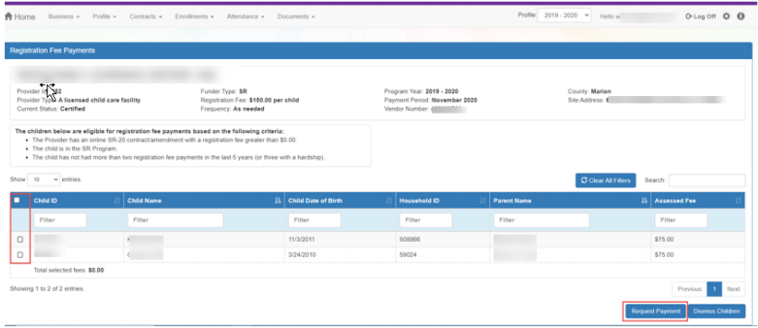
SR Registration Fees (cont.)
The Registration Fee Payments screen lists children who are eligible for Registration Fee payments. To request a payment, check the checkboxes and click Request Payment button.

Slide 32
SR Registration Fees (cont.)
If your program has already collected the registration fee from the family, the child is not eligible for a Registration Fee payment and the child/children will need to be dismissed from the request. To dismiss a child/children, please follow the instructions attached.
Request for payment will be due by the second business day of each month and will be paid monthly along with your School Readiness monthly payment.

Slide 33
1099 Tax Forms
The 1099 Tax Forms will be mailed out by 1/31/21 to all providers that are not listed as a corporation.
Corporations that need their payment information, can contact the Reimbursement Department and request a payment history.

Slide 34
Reimbursement Department Staff
If you run into any issues or questions regarding Reimbursement, SR or VPK, please reach out to the Reimbursement Department at (904) 726-1500 ext 7050.
Brianna DeOsca, Reimbursement Coordinator, ext. 2221
Christy Bramley, Reimbursement Specialist, ext. 2257
Courtney Cariveau, Reimbursement Specialist, ext. 2293
Darius Cannon, Reimbursement Specialist, ext. 2239

Slide 35
Questions?

Slide 36
Contract Department

Slide 37
School Readiness Contracts 20-21
A School Readiness Contract Extension was issued to allow for the following :
To allow for CLASS assessments that were unable to be completed for 20-21 or to allow providers the opportunity to be reassessed if requested.
To allow for School Readiness Health & Safety Inspections to be completed by DCF.
To allow for 20-21 Provider Profiles to be Submitted and made Active
If your program has not met the above items, then you will continue to be covered under the SR Contract Extension.
If your SR Contract for 20-21 has been certified, then you are also required to complete a Contract Amendment Extension to cover the gap between your 19-20 and 20-21 Contract.

Slide 38
VPK Assessment Due Dates
The current deadlines for assessments are as follows :
AP1’s must be administered within 30 calendar days of your class start date and entered into Bright Beginnings within 45 calendar days of your class start.
AP2’s are optional unless you are a POP and have chosen Staff Development as your Improvement Plan. The assessments should be completed in January 21 and entered into Bright Beginnings by 2/15/21.
AP3’s must be administered 30 calendar days prior to the last day of your VPK class and entered into Bright Beginnings no later than 15 calendar days after the last day of your VPK class.
If a provider fails to comply with the pre- and post-assessment requirements, the providers eligibility to offer VPK is required to be revoked for a period of five years.

Slide 39
Temporary Closures
OEL is following the standard practice of paying for temporary closures due to COVID or another state of emergency in accordance with rules 6M-4.501 (SR) and 6M-8.204(5), F.A.C (VPK). Please note that absences are not counted during a temporary closure due to a state of emergency.
As temporary closures occur, use the reporting form on the statewide system under the Attendance menu item in the Provider Portal. This short form allows you to report when and why your site was temporarily closed, include comments and supporting documentation (if any), and then submit to your contracted early learning coalition(s) so they may add the appropriate reimbursement indicator. Once processed, the temporary closure will appear as an asterisk on the attendance roster.

Slide 40
Temporary Closures (cont.)

Slide 41
Temporary Closures (cont.)

Slide 43
Temporary Closures (cont.)
For School Readiness Programs:
Coalitions must, at a minimum, evaluate and document information to determine if a provider is eligible to receive payment during their closure. If the Health Department determines that your program needs to close, please email ccrrhotline@ecs4kids.org with the following information:
The length of the closure
Number of children enrolled
Number of parents that have requested a transfer to an open program
Reopening plan
Plan to allocate SR funding, in part, to wages or bonuses to retain staff while closed, as applicable.
The Coalition will evaluate this information submitted as well as consider the essential local childcare capacity need in the programs service area and the Covid-19 infection rate of the service area.

Slide 44
Temporary Closures (cont.)
For VPK Programs:
VPK programs will follow rule 6M-8.204 – Uniform Attendance Policy for Funding the VPK Program regarding temporary closures. During temporary closures caused by emergency circumstances a student is considered to have attended and will be reimbursed all VPK program hours offered during a temporary closure caused by emergency circumstances for a combined total of five (5) instructional days for each VPK class if the provider submits notification in writing to the coalition the dates which the provider was closed. However, a temporary closure caused by emergency circumstances is not payable for any student who does not attend a VPK instructional day following the closure. A provider shall revise its class schedule to restore VPK instructional days which are lost due to temporary closures caused by emergency circumstances in excess of a total of five (5) instructional days for a VPK class. Additionally, a provider may revise its class schedule to restore the instructional days lost as a result of a temporary closure caused by emergency circumstances instead of accepting payment for a temporary closure.
If your VPK program is instructed by the local Health Department to close, please complete the VPK Initial Notification of Closure form attached by the end of the business on the first day of closure and email to ccrrhotline@ecs4kids.org. Once your VPK program is able to resume, please complete the VPK resumption of Services within two business days following the resumption of services to ccrrhotline@ecs4kids.org. You will also need to update your calendar/class in your VPK Application based on the attached guidance.

Slide 45
VPK Summer Classrooms for 2020-21
If you plan on offering VPK for Summer 2021, please go to you 20/21 VPK application and set up your summer calendar and summer classroom. You can add new teachers as you normally would or if it is an existing teacher that is Summer qualified you can use that teacher and just need to assign them to the Summer classroom.

Slide 46
Annual Provider Update Process
6M-9.300 (8)(a) Provider Updates
Each CCR&R Organization shall ensure that provider information for each legally operating childcare, early learning or school-age provider, and each provider receiving state or federal funds within the CCR&R organization's service area, is updated and approved between
January 1 and May 31 of each calendar year in the single statewide information system maintained by the Office of Early Learning.
The 2021-22 Profiles are now available to be completed and submitted
Your 2021-22 Profile must be active before we can begin the process for contracting for SR & VPK. The SR & VPK Contracts should be available in March.

Slide 47
E-Verify Requirements
Effective January 1, 2021 per the Office of Early Learning all contracted childcare providers will be required to use E-Verify for all new hires. Therefore, there is now an additional requirement for the 2021-2022 Provider Profiles that all contracted School Readiness and VPK providers need to complete.
Providers are now required to sign and upload an affidavit stating that it does not employ, contract with, or subcontract with an unauthorized alien. The affidavit must be notarized. ECS will not be able to certify any new contracts after January 1, 2021 without an uploaded affidavit as ECS is now required to maintain a copy on file.
In addition to completing the affidavit, you are required to register for E-Verify at https://www.e-verify.gov/
Enrolling in E-Verify is a simple and easy process, open to any U.S. employer. To help you get started, a short video showing the step-by-step process is available at the following link:
https://www.youtube.com/watch?v=INoFQTYlOAQ&feature=youtu.be.

Slide 48
Contract Department Staff
If you have any questions regarding Profiles or Contracts, SR or VPK, please reach out to the Contract Department at (904) 726-1500 ext 7054.
Sarah March, Contract Coordinator, ext. 2206
Roushawn Saunders, Contract Specialist, ext. 2241
Robin Morse, Contract Specialist, ext. 2101
Melisha Farmer, Contract Monitor, ext. 2243

Slide 49
Questions?

Slide 50
School Readiness Education

Slide 51
CLASS Assessments
In order to contract for SR services for 2021-2022 year, providers must achieve a 4.0 or above on the composite CLASS score.
These assessments are being conducted this current year.
Providers that do not meet the required threshold will have two options this year:
Request (in writing) a second assessment to be completed by a 3rd party assessor, if available, at the provider’s expense of $250 per required assessment (this amount currently does not cover the acutal amount of assessment costs and may be increased in the near future.
Participate in a Quality Improvement Plan (QIP) for an average of 9 months prior to another assessment being conducted (by ECS, no cost to provider). The composite score for the post-QIP assessment will be used to determine provider contract eligibility.
This Photo by Unknown Author is licensed under CC BY-SA-NC

Slide 52
Quality Improvement Plan (QIP)
Different requirements (strategies) depending on where your composite score falls.
Could include: Required trainings and/or coaching.
If your program is placed on a QIP, ECS will let you know what strategies are required or offered based on your score.

Slide 53
Exemptions for CLASS
Exempt providers- can remain exempt unless site receives qualifying DCF violations and/or SR enrollment exceeds the 20% SR enrollment threshold.
Biannual providers- if you received a composite score of 5 or above last year, your assessment will be skipped this year unless your site receives qualifying DCF violations and/or site does not retain 80% of teaching staff throughout the year.

Slide 54
CLASS Training/Resources
It is extremely important for teachers to receive on-going CLASS training. Please do not assume that your center will receive a score similar to your last year’s score if your teachers have not continued to train on CLASS.
CLASS strategies and scoring are very specific. Directors should have a training plan in place for seasoned teachers as well as new teachers
Be sure to take advantage of the FREE MyTeachstone accounts we have been advertising. This resource has a library of information, courses, and videos on every area of CLASS in each of the 3 age ranges (Infant, Toddler, PreK).

Slide 55
MyTeachstone Accounts
If you would like to sign up yourself and your teachers for an account, you can reach out to your assigned Education Specialist or Amanda.Griffis@ecs4kids.org .
Send a list of first and last names and an individual email address.

Slide 56
MyTeachstone Accounts (cont’d)
Search for the CLASS area you are interested in learning about.
Choose the ‘type’ of learning material you are interested in viewing (video, link, PDF, Course).

Slide 57
MyTeachstone Accounts (cont’d)
Scroll down and choose the age level you wish to learn about.

Slide 58
Other CLASS Learning Opportunities
Check the ECS training calendar:
https://ecs4kids.gosignmeup.com/Public/Course/Browse
Check the Early Learning Florida Training Calendar
https://www.earlylearningflorida.com/catalog
Read the ECS Helping Hands Monthly Newsletter
Includes CLASS strategies in the activities
Read the Book of the Month activities/ Watch the BOM videos
Includes CLASS strategies in the activities
Posted to “ECS In The Know” Provider Facebook Group
Visit the Teachstone website for products to use in the classroom
https://teachstone.com/
Reminder: For providers who received the CLASS strategy cards and CLASS dictionary- be intentional about using these materials in the classroom.
Directors- ensure lesson plans are being created with CLASS strategies in mind, complete informal CLASS strategy observations; create training plans for each staff member that include formal and informal CLASS training

Slide 59
Quality Performance System Staff Rosters
Staff rosters must be updated and submitted monthly (by the 20th of each month).
Staff rosters and CLASS registration are separate requirements. If you receive an email to complete registration for CLASS assessments, you must complete the registration and make sure your roster is complete and submitted.
Family Child Care providers must also submit staff rosters, even if there is only 1 staff member (themselves).

Slide 60
ASQs in the Provider/ Parent Portal
In March 2021, updates are expected in the Parent and Provider Portal to include ASQ information and links to complete the ASQs within the portal.
ECS will update providers as we receive training and more information on this functionality.

Slide 61
ASQ Completion Reminders
ASQs are required (Covid waiver expired last year!)
If you have a child that is enrolled but not attending, the ASQ is still required. Please partner with the child’s guardians if help is needed to complete the ASQ.
Enrollment ASQs are completed by the parent/guardian at time of enrollment, if for some reason it cannot be completed at that time, then the provider is responsible for completion.
Annual ASQs are completed in the birth month of the child. Annuals are completed by the provider.
Please be sure to submit your ASQs as soon as possible after receiving the email from your Screening Specialist.
Failure to complete ASQs as required by Rule, will result in a Non-compliance notice for your site.

Slide 62
ASQ Completion Reminders
If a child has been disenrolled from your site, or has never attended, be sure to notify your Screening Specialist when you receive the ASQ email from them (along with last day of enrollment as applicable). If the child was at the center for the majority of the month, please complete the assessment.
Providers contracted with more than one coalition:
Make sure you are using the specific link we provide in the email from your screening specialist. If you use another coalition’s link, we will not receive the ASQ, and it must be completed again through our link.

Slide 63
School Readiness Education questions?

Slide 64
Questions and Answers

Slide 65
SR Provider Survey
You will receive an email with the link to a survey. Please take the time to fill this out. We use your feedback to guide future Provider Meetings☺ THANKS!!!

Slide 66
More Questions
Amanda Griffis Brittney Spangler
(904)726-1500 x 2255 (904)726-1500 x 2229
Amanda.griffis@ecs4kids.org brittney.spangler@ecs4kids.org
Ashley Rich Shanda Ellis Alicia Williams-Baltzell
(904)726-1500 x 2274 (904)726-1500 x 2253 (904)726-1500 x 2283
Ashley.rich@ecs4kids.org shanda.ellis@ecs4kids.org alicia.williams@ecs4kids.org

